Slide 1

B18 Lesson 5
Bishop Stopford School
faith | justice | responsibility | truth | compassion
ONLINE LEARNING
Learning Objectives
Retrieval
Acquire
Action
Review
Dig Deeper

Slide 2
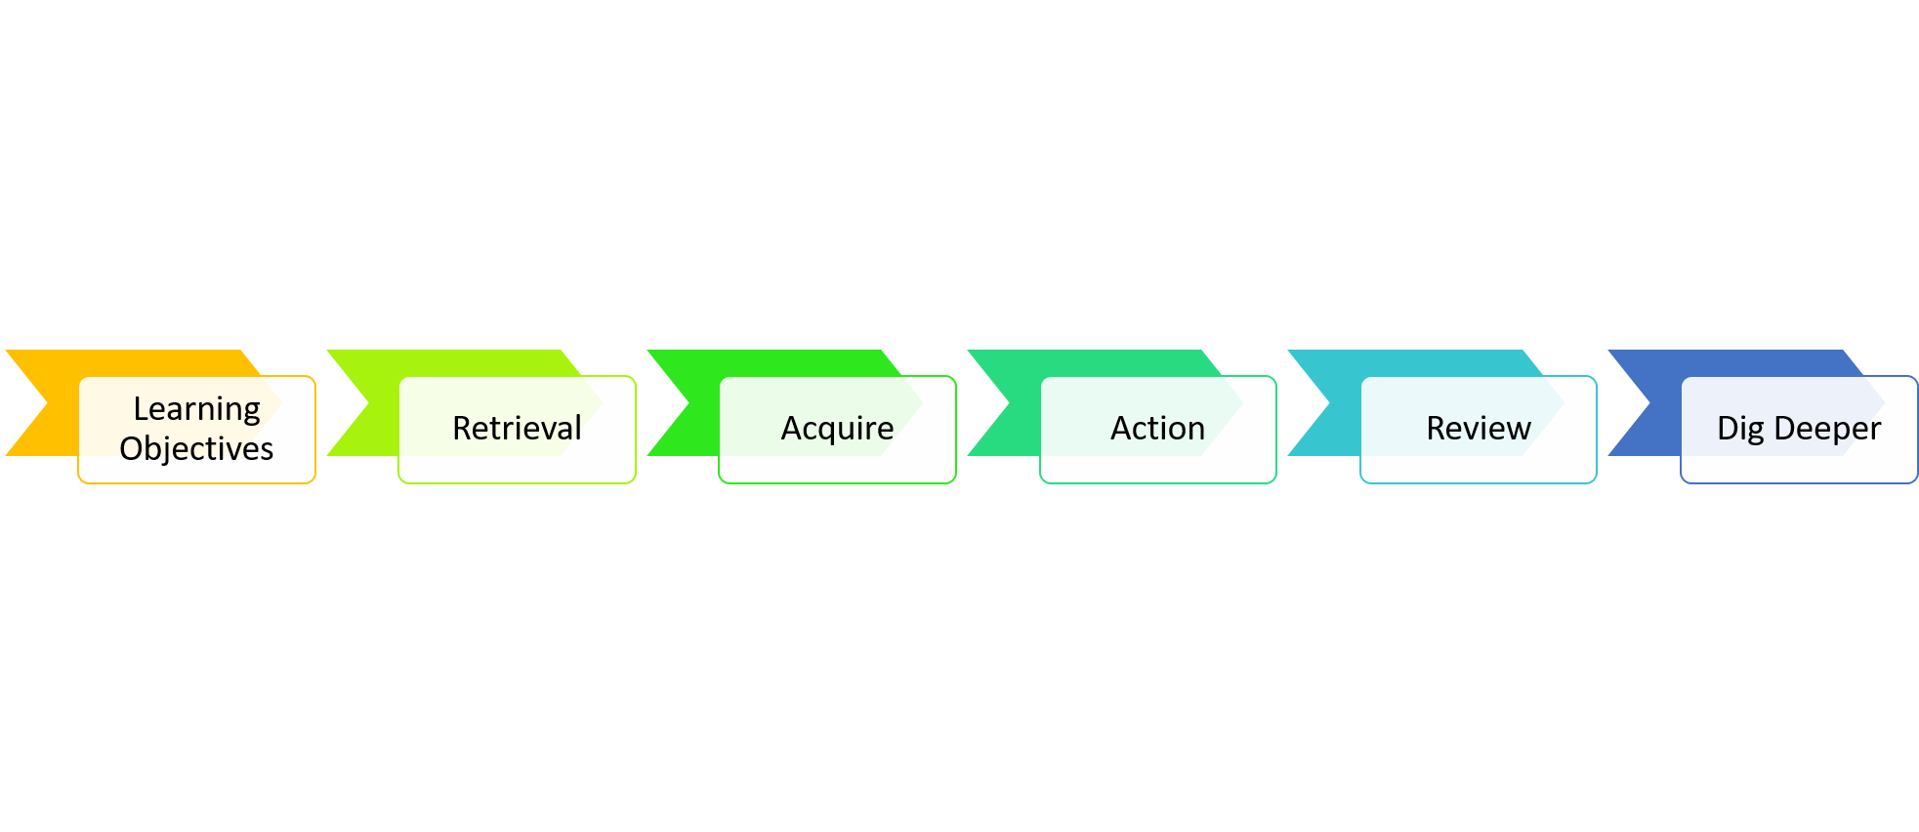
The Impact of Change
Learning Objectives
1.State factors that affect the distribution of organisms
2.Suggest how environmental change will affect the distribution of an organism.
3.Interpret environmental data

Slide 3
Starter – Retrieval Questions
1) Name 2 greenhouse gasses
2) State what is meant by the term biodiversity
3) Give 2 reasons why humans cut down forests

Slide 4
Starter – Retrieval Answers
Name 2 greenhouse gasses
Carbon dioxide and Methane
2) State what is meant by the term biodiversity
Biodiversity is the variety of all the different species of organisms on earth, or within an ecosystem
3) Give 2 reasons why humans cut down forests
(to provide land) for farming / agriculture
(to provide land) for quarrying
(to provide land) for building
to provide wood for building materials
to provide fuel
to provide paper

Slide 5


Watch the video
You can watch this video as many times as you want to
https://www.youtube.com/watch?v=fZxw0QiaSN4

Slide 6
Key Notes
The environment has a big effect on where an organism lives. You wouldn’t find a polar bear living in the desert! If the environment changes it can cause a change in the distribution of organisms. Some of theses changes are natural (for example seasonal changes in temperature) Some changes are the result of human activity (e.g. global warming and pollution)

Slide 7
Task
Complete the Changing Birds of Britain worksheet
https://bishopstopford.fireflycloud.net/science-2/school-closure-tasks/year-10-1/biology/triple/b18-biodiveristy-and-ecosystems

Slide 8

Review Part 1
Once you have completed the changing Birds of Britain worksheet, use the mark scheme to self-assess your answers. Add a score, WWW/EBI.
https://bishopstopford.fireflycloud.net/science-2/school-closure-tasks/year-10-1/biology/triple/b18-biodiveristy-and-ecosystems

Slide 9
Review Part 2
Complete the following interactive kerboodle tasks to review the topic so far
https://www.kerboodle.com/app/courses/19899/modules/Resources/node/15485/page/1/content/154389,154391,154387,154390,154395,154396,154394

Slide 10
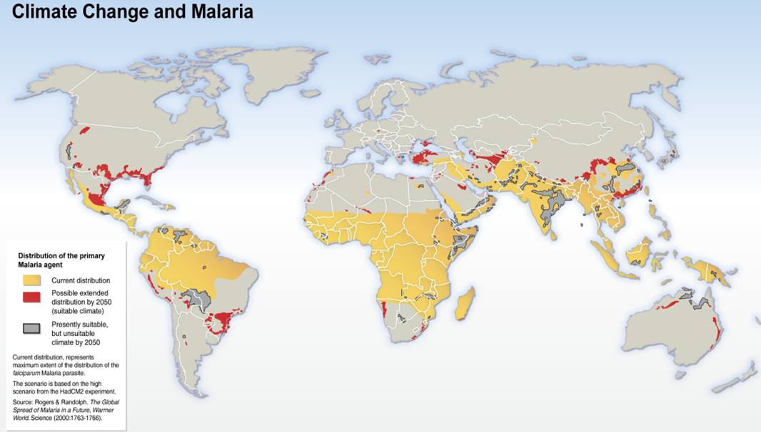
Dig deeper (optional)
Research how climate change is affecting the distribution of mosquito and what impact this might have on the spread of diseases such as malaria. Write a couple of paragraphs summarising what you found out

